Slide 1
Motivation
John Collins

Slide 2
What is Motivation
Motivation is a leader’s (or organization’s) ability to understand intrinsic values and drives of individuals and team and create the environment which leads to top performance.

Slide 3
Importance of Motivation
No leader can accomplish long term success without teams being intrinsically motivated.
“Motivation” through coercion or threat only works as long as the stimulus is present and typically generates minimum acceptable output.
Intrinsically motivated employees and teams typically over perform and exceed goals.

Slide 4
Motivators and Hygiene
Factors that cause job satisfaction (motivators) and dissatisfaction (hygiene) are not simply opposites.
Motivators should be stresses and hygiene should be eliminated or minimized.
Jobs can be enriched through vertical loading.
Select jobs in which investment is industrial engineering does not make changes too costly, attitudes are poor, etc.
Approach these jobs with conviction that they can be changed
Brainstorm list of changes that may enrich the jobs
Screen list to eliminate suggestions that involve hygiene rather than motivation
Screen the list for generalities that are rarely followed
Screen list to eliminate horizontal loading suggestions
Avoid direct participation by the employees whose jobs are to be enriched
Set up a control group to progress can be measured.
Be prepared for an initial drop in performance during the first few weeks of execution
Expect first line supervisors to become anxious because the nature of roles is being adjusted.

Slide 5
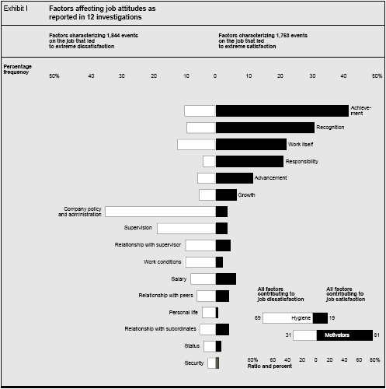
Motivators and Hygiene

Slide 6
Motivating Employees
Employee are unique and therefore specific and different needs will drive different levels of motivation
Encourage entrepreneurial thinking.
Link motivation to performance. You should expect the best to get the best out of them.
Get employees to accept responsibility for their motivation
Instill feeling of hope and trust
Make work fun
Combat de-motivators and dissatisfiers.
Motivate for good team work

Slide 7
Motivation Management
Motivation is future oriented and based on what employees believe will happen
Three beliefs must be in place to make motivation possible.
Confidence ; “ I can do it”
Trust ; “Outcomes are tied to my performance”
Satisfaction ; “The outcomes will result in personal satisfaction”
Motivation problems can be handled through these steps:
Identify the cause of the problem. Dig beneath the symptoms; don’t focus only on performance.
Learn what is wrong by asking and dialog, not just observing.
Find solutions that should have something to do with the beliefs listed above. Listen and be open

Slide 8
Integrating Theories
Leveraging time to integrate features of motivational theories such as :
Picoeconomics,
Expectancy theory,
Cumulative prospect theory
Need theory
Creates Temporal Motivational Theory
Based on knowledge that
Rewards that are distant are underappreciated
Rewards that are near term are overinflated

Slide 9
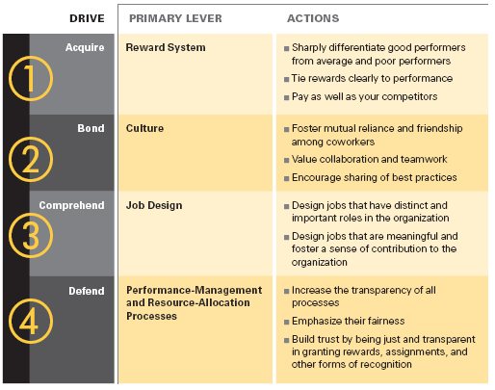
Motivation: 4 Drives
Motivation can be influenced by understanding four basic drives that are hardwired into all human brains.

Slide 10
What Great Managers Do
Think of each employee as a chess piece (vs. checkers) with unique moves and characteristics
Three things to know in order to turn individual talent into performance
What are this person’s strengths?
What are the triggers that activate those strengths?
How does this person learn?
Learn by doing
Learn by watching
Learn by analyzing

Slide 11
Work Motivation Theory and Practice
Endogenous theories include
arousal/activation theory,
expectancy-valence theory,
equity theory,
attitude theory,
intention/goal theory,
attribution/self-efficacy theory
Exogenous theories include:
Motive/need theory
incentive/reward theory
reinforcement theory
goal theory
personal and material resource theory
group and norm theory
sociotechnical system theory
Exogenous theories provide action levers to change work motivation

Slide 12
Work Motivation Theory and Practice
Strategy | Motivational imperative | Illustrative programs
Personal motives and values | Workers motives and values must be appropriate for their jobs | -Personnel selection -Job Previews -Motive training -Socialization
Incentives and rewards | Make jobs attractive, interesting and satisfying | -Job security -Career development - Job enrichment -Recognition
Reinforcement | Effective performance must be positivelyi reinforced | -Financial incentive plans -Behavioral analysis -Praise and criticism
Goal setting techniques | Work goals must be clear, challenging, attainable, and attractive | -Goal setting -Management by objectives -Modeling -Appraisal and feedback
Personal and material resources | Provide needed resources and eliminate constraints | -Training and development -Coaching and counseling -Technology
Social and group factors | Interpersonal and group processes must support goal attainment | -Division of labor -Group composition -Team development
Sociotechnical systems | Personal, social, and technological paramaters must be harmonious | -Quality of work/life programs -Organizational development

Slide 13
Demystifying Motivation
A leader should create an environment where employees feel
Respected
Appreciated
There is an environment of honest communication that includes issue resolution
Dignity and respect manifested as equal and fair treatment
Appropriate rewards and recognition
Managers should remember the hot stove principle to ensure fairness and consistency; a hot stove:
Is consistent – it burns every time
Is immediate – it burns right away
Does not apologize – it makes no apology for burning
It forewarns –the closer you get the hotter it feels
Is impersonal – it does not care about rank or title
Shows no emotion

Slide 14
Exercise #1
Objective: To identify what motivates people to work
Stack rank the following :
What do people want from their jobs?
________ Promotion in the Company
________ Tactful Discipline
________ Job Security
________ Help with Personal Problems
________ Personal Loyalty of Supervisor
________ High Wages
________ Full Appreciation of Work Done
________ Good Working Conditions
________ Feeling of Being In on Things
________ Interesting Work
Compare answers to common supervisor and employee results and discuss.

Slide 15
Exercise #2
Objective: Discover and understand group norms
Explain the idea of workplace norms to the group
Give an example of charting job satisfaction level vs frequency
Ask the group to come up with their own examples of actual workplace norms and chart them.
Have a discussion with the team and jointly analyze the graphed results

