Slide 1
Managing Change
John Collins

Slide 2
What is Managing Change
Managing Change or Change Management is successfully guiding an organization, or team through a transformation of culture, work process, or ideals.
Tools and techniques navigate the people side of the transformation
The need for change can be in response to an opportunity or threat

Slide 3
Importance of Change Management
All teams and organizations need to adapt to shifts in customer base or their markets.
Examples
Dell and the PC business
Digital photography to Kodak
Amazon to retail book sellers
Apple to retail record stores.
Over reliance on practices, products, etc. that made companies successful in the past can cause them to fail in the future

Slide 4
Change Management Excellence
4 Forms of intelligence
Business intelligence has three critical skills
Political intelligence is about influencing others
Emotional is realizing how your feelings and others’ feelings affect organizational change
Spiritual intelligence is based on a strong value system and openness to ideas
4 Stages for managing a change initiative
“Set up” – Prepare others for the reality that change is going to come, spell out how they will be affected.
“Kick off” – Meet with the task force or the leaders of the change initiative.
“Delivery” – Encourage others to step into their new responsibilities. Monitor your organization’s progress.
“Review” – Reconsider what you would do differently next time.

Slide 5
Leading Change
8 Steps to failure
Allowing too much complacency
Failing to create sufficiently powerful coalition
Underestimate the power of vision
Under communicate the vision
Permitting obstacles to block the vision
Failing to create quick wins
Declaring victory too soon
Neglecting to anchor the change in the corporate culture
8 Steps to success
Establish a sense of urgency
Create the guiding coalition
Develop a vision and strategy
Communicate the change vision
Empowering employees for broad based action
Generating quick wins
Consolidating gains
Anchoring new approach in the culture

Slide 6
Art of Engagement
Six primary obstacles
I cannot be engaged if I am overwhelmed
I cannot be engaged if I do not get it
I cannot be engaged if I am scared
I cannot be engaged if I do not get the big picture
I cannot be engaged if it is not mine
I cannot be engaged if my leaders do not face reality
Six tactics
Connect through images and stories. Use infographics and murals to help communicate the big picture
Create pictures together. Team members help to create the visuals that will be used to describe the need for change.
Believe in the leaders. Have frank conversations about people’s opinions, attitudes, and beliefs. Own the solutions. Allow small groups of employees personalize the issues at hand.
Play the entire game. Employees want their voices heard; they want to express themselves and know their suggestions matter.
Practice before performing. Allow employees to experiment and try new ways of doing things without fear of being penalized if they make mistakes.

Slide 7
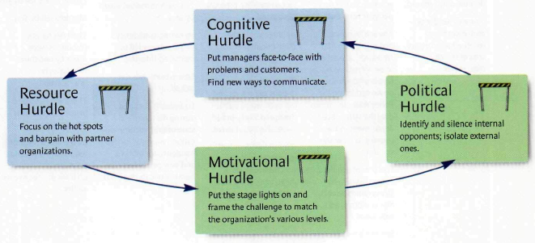
Tipping Point Leadership

Slide 8
Why Employees Resist Change
Three dimensions or compacts must be revised
Formal dimension which includes position descriptions and job requirements.
Psychological dimension is where trust and respect are built. Motivation to go the extra mile.
Social dimension weighs the employees values and personal ethics against the company’s.
Revising these personal compacts is done in three phases.
Leaders highlight the need for change and establish the context for revising the compacts.
Start process where the employees revise and buy into the compact revisions.
Lock in commitments with new formal and informal rules.

Slide 9
Exercise #1
Objective: Perform a series of exercises to build upon the least understood of culture intelligence, the spiritual dimension
Perform these actions as a way to build spiritual intelligence.
Pick a relationship you want to improve. Apply your spiritual nature to that goal.
Find people you feel uncomfortable with; engage them in conversation.
Ask your family and friends for honest feedback on your strengths and weaknesses.
Create a description of yourself that portrays who you really are. Keep it. Refer to it regularly.
Keep a journal of reflections about what’s really important to you.
Name three things to do this month to make you and your loved ones happier.
Create a personal vision for your future state of being, a life plan.
List your organization’s values. How do they translate into employee behavior?

Slide 10
Exercise #2
Objective: Highlight the fact that there is no such thing as over communication during a change event
Discuss with the team about the importance of communicating during a change. Have each individual write down
5 reasons why communication is important
5 effective methods that could be used to communicate change
5 factors that could cause employees to resist change
1 time they were involved in a change that did not go well
Have each team member discuss and share their answers with the group.

