Slide 1
Business Strategy
John Collins

Slide 2
What is Business Strategy
Strategy is a method or plan for bring about desired results through marshaling resources for their most efficient and effective use.
Strategy is different from vision, mission, goals, priorities, and plans. It is the result of choices executives make, on where to play and how to win, to maximize long-term value.*
Maximizing long term value is not the same as maximizing share price and does not mean disregarding the short term.
* Booz & Co., summer 2012

Slide 3
Importance of Business Strategy
A sound strategic plans allows companies to outmaneuver their completion
Getting there fast is no good if you are going in the wrong direction
Market forces continually conspire to deplete profits. Powerful business strategies can counteract those tendencies.
Many, many tools to use
Porters five forces
Blue Ocean Strategy
McKinsey’s strategy building blocks
The Art of War
The Art of the Advantage

Slide 4
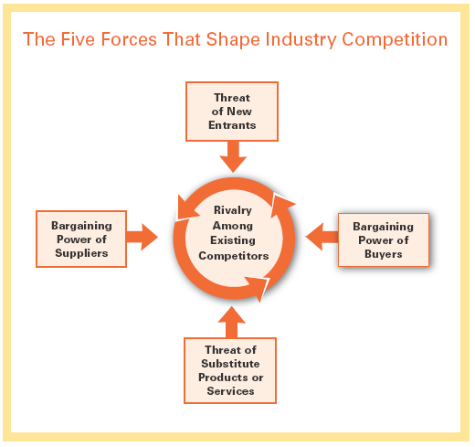
Porters Five Forces

Slide 5
Blue Ocean Strategy

Slide 6
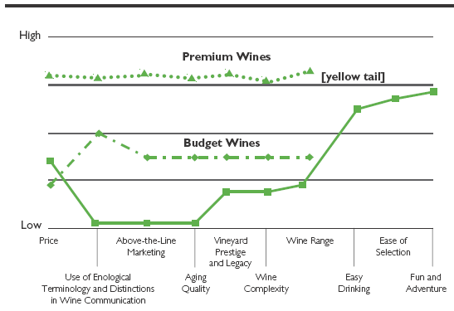
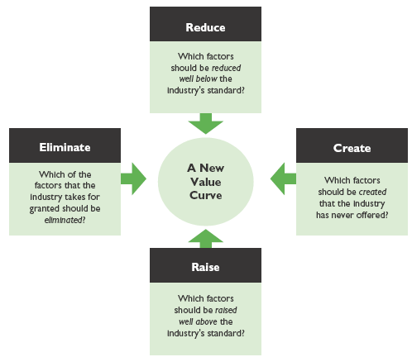
Blue Ocean Practice
Redefined strategy canvas for wine industry
Four actions framework
New Blue Ocean
Competitive factors

Slide 7
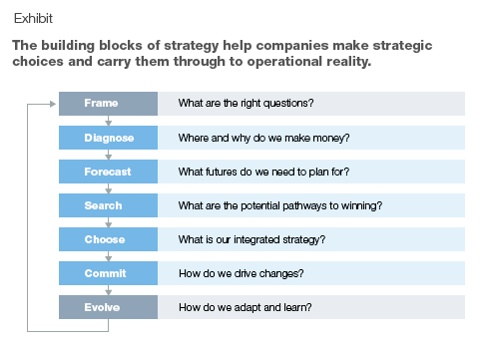
Building Blocks of Strategy

Slide 8
Exercise #1
Objective: The objective of this exercise is to increase skill at creating a strategy canvas that can be used to develop a blue ocean strategy
Break the group into teams of two. Explain the principle of the strategy canvas. Each team will need to decide the factors that company’s in its industry compete on. Each team will create a rating for their own company, each of their two biggest competitors, and the rest of the industry as a whole if applicable. End the exercise by having each team present their results and the entire group settle on a strategy canvas that represents their industry.

Slide 9
Exercise #2
Objective: The objective of this exercise is to increase the skill using Michael Porter’s 5 forces model during strategy planning.
Break the group into teams of five. Each person will be assigned one of the five factors in the model to complete on their own company in 5 minutes. After 5 minutes, each person will take 5 minutes to share their thoughts with the group and receive feedback and additional inputs. If there is more than one group, have the groups converge and create a single model as an output.

